Slide 1


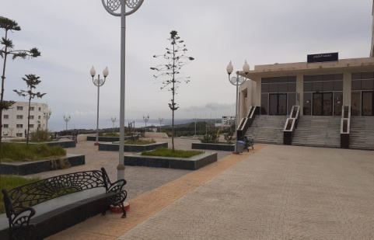
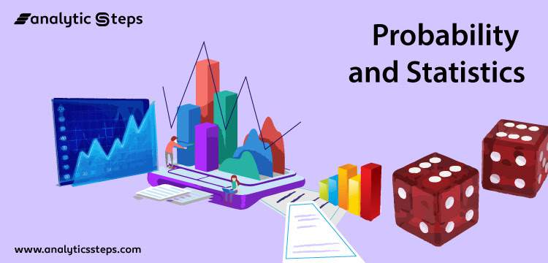
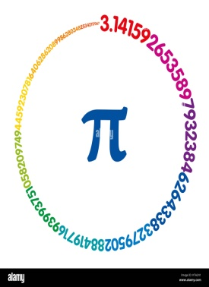
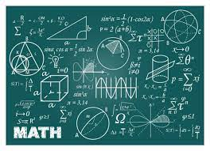
Ministry of Higher Education and Scientific Research
University Center of Tipaza
Morsli Abdellah
Address: Oued Merzoug –Tipaza
Phone number: 024371003
Email address: cunivt.st@gmail.com
Institute of Science
MCS Department
Access conditions:
The online registrations
allow the new bachelors in
the following streams:
Mathematics
Technical Mathematics
Experimental Sciences
to fill in the wish card according to the ministerial prospectus.
Area of Studies: Mathematics and Computer Science (MCS)
Licence
Mathematics
Licence
Applied Mathematics
Master
Doctorate
In Mathematics

Slide 2
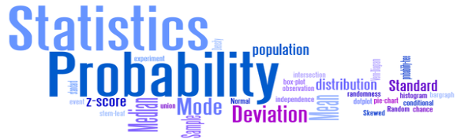
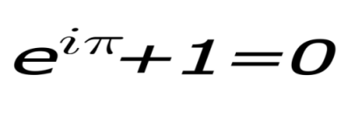
5.First year MCS Courses
Goals:
The student will have to possess and acquire the basic notions in Mathematics, Applied Mathematics that are necessary to prepare a Master's degree, eventually a Doctorate degree, to teach and do research at the university in Mathematics, Computer Sciences, Physics, Chemistry or Economics).
On the other hand, the student must master the useful tools to exercise a profession in management services, statistical studies and others.
2- Profiles and Targeted skills :
3-Gateways to other specialties
Academic Licence in Computer Science
Academic Licence in Science and Technology
Academic Licence in Material Sciences
Academic Degree in Economics.
4- Potential employability:
In addition to the traditional profession (Primary, middle and secondary education)
This licence opens the doors to any Master in the area studies of Mathematics and Computer Science.
This licence gives the possibility to access management professions after an accelerated training,
Teaching units | First Semester | Second Semester
Fondamental unit | Mathematics Analysis 1 | Mathematics Analysis 2
 | Algebra1 | Algebra 2
 | Algorithmic and Data Base Structure 1 | Algorithmic and Data Base Structure 2
 | Machinal structure1 | Machinal structre 2
Methodology unit | Scientific Termenology and Written Expression | Introduction to probability and descriptive statistics
 | Foreing language 2 | Data and communication Technology
 | :::::::::::::::::::::::::: | Programming tools for Mathematics
Discovery unit | Physics1 | Physics 2
The level of skills acquired in the under-graduation studies allows the integration to an academic or professional Master's degree in Mathematics.

